Slide 1
Shiny And Flex Dashboards
Class 5

Slide 2
Agenda
Homework 2 Questions?
Shiny Dashboard
Flexdashboard
Publishing to shinyapps.io
Packages for next week!

Slide 3
Any questions for homework 2?
Or wait for office hours. The choice is yours

Slide 4
Shiny Dashboard

Slide 5
Basic Layout
Dashboards are broken into a single argument made up of three arguments
Header – Window title as well as Menus
Sidebar – Sidebar for navigating Dashboard tabs and can hold global selection inputs
Body – Where the magic happens.

Slide 6
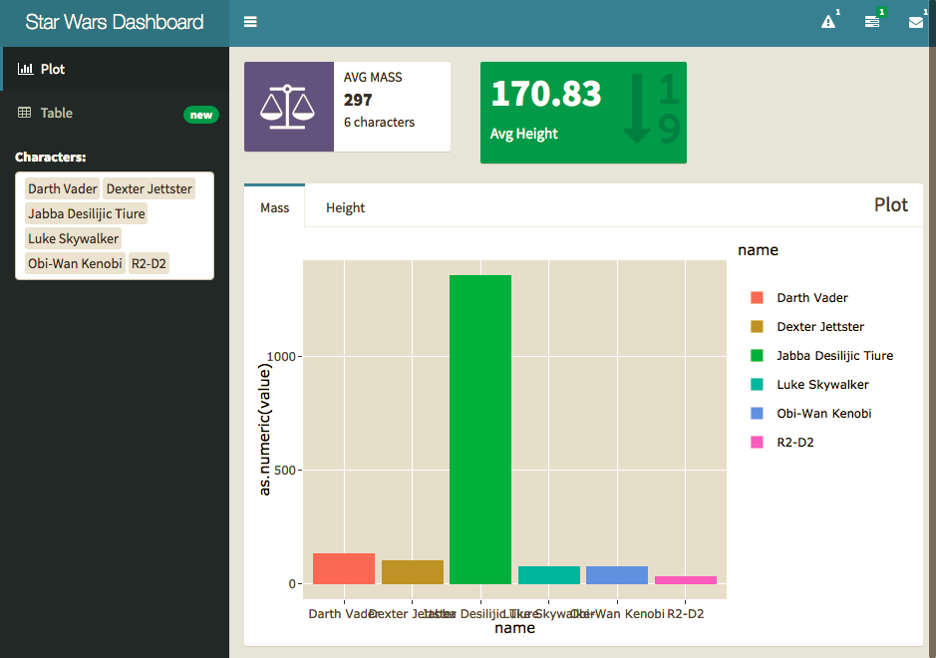

Slide 7
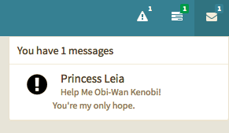
Headers

Slide 8
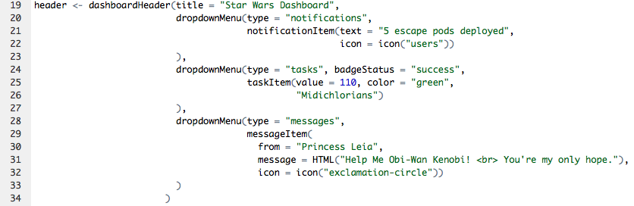

Options
Notifications
Tasks
Messages

Slide 9
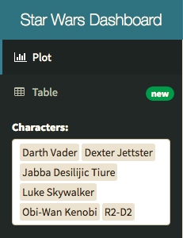
Sidebar

Slide 10
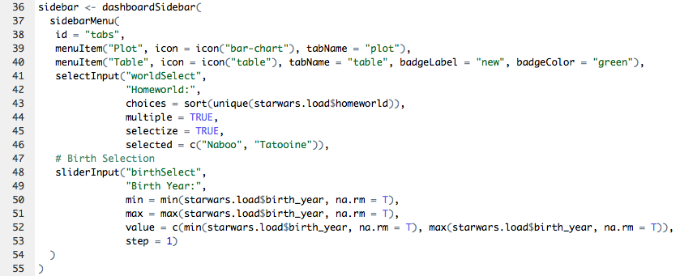
Menu Items – tabName referenced in body.
Global Inputs – Should work on all tabs and for all visuals.

Slide 11
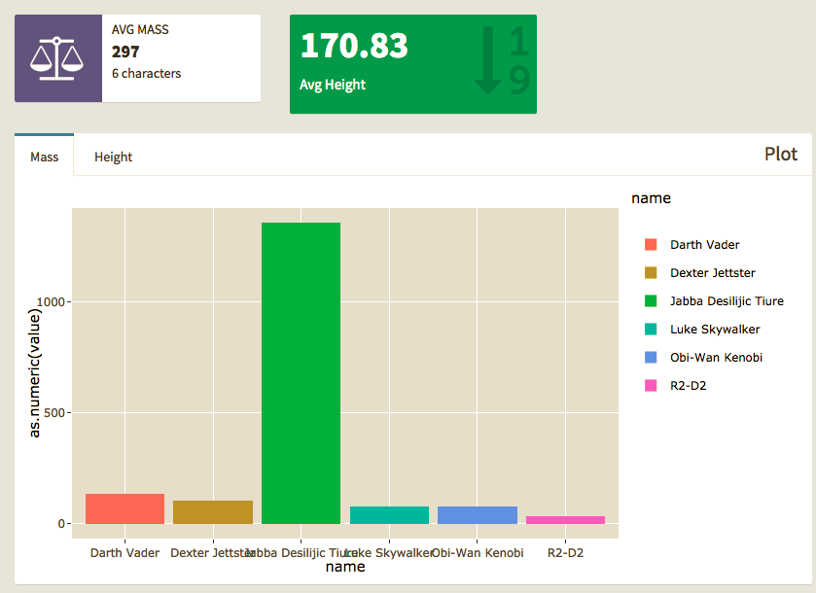
Body

Slide 12
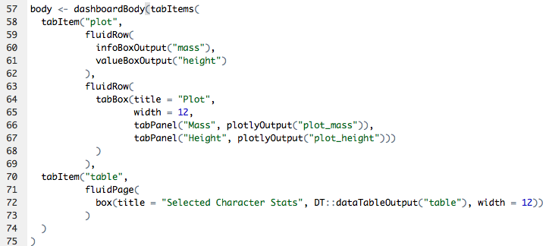
Tab Items – by name in Menu
Row\Page – based layouts
Box – All contents should go in a box
Page is broken into 12 equal bars. Width can be 1-12
If 12+ is specified content will kick to new row automatically, anything unspecified will get squished.
Inputs – can also go in boxes here should be clear what visuals they work with.

Slide 13
Flexdashboard

Slide 14

Basic Concepts
You can orientate by rows or columns
Each UI element is broken up by three “#” signs
Adding {.tabset} after element can make the element tabbed
Similarly {.no-mobile} makes the row/column only show up on wider displays

Slide 15
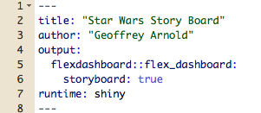
Setup
This uses .yml formating

Slide 16
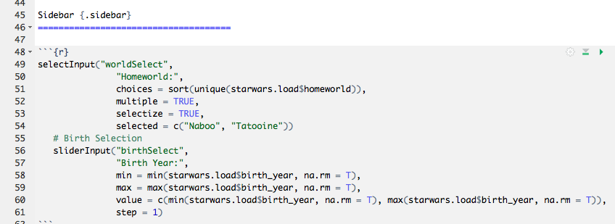
Side Bars – Global

Slide 17
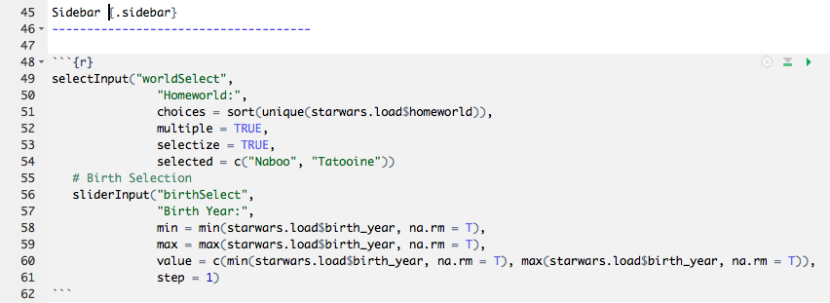
Side Bars – Single Page

Slide 18
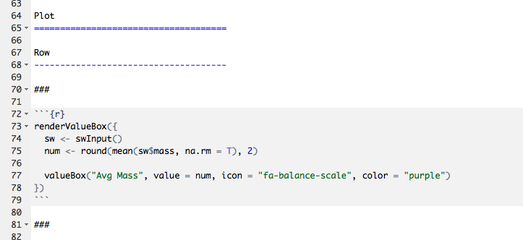
Basic Board Page

Slide 19
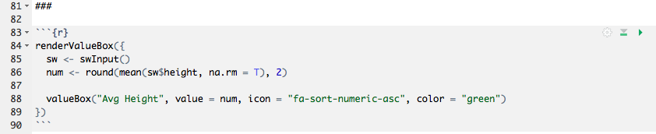
Value Boxes (no info boxes in flex)

Slide 20
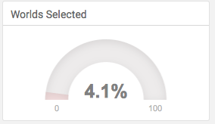
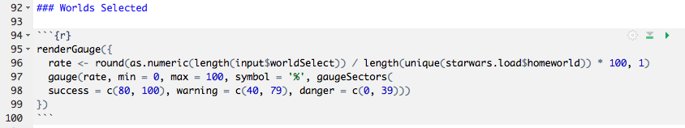
Gauges

Slide 21
Practice
Storyboard - Blank

Slide 22
Shiny Apps.io
http://www.shinyapps.io/

Slide 23
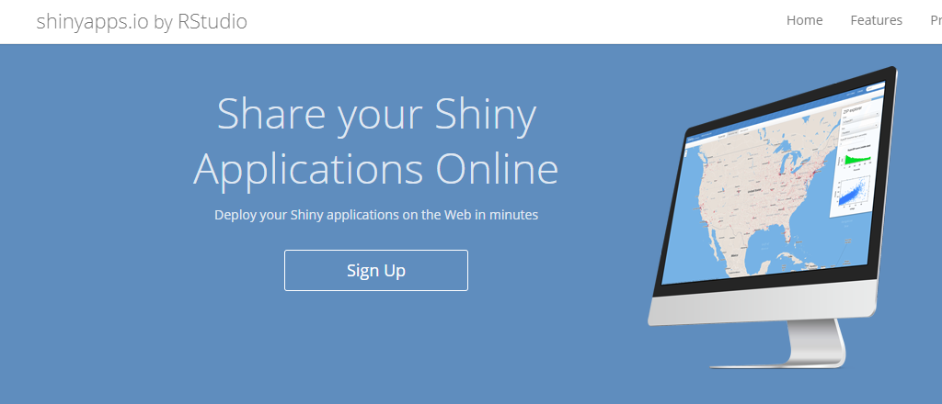
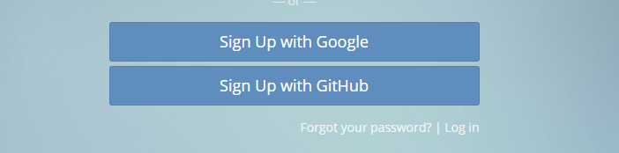
Register a free Account

Slide 24
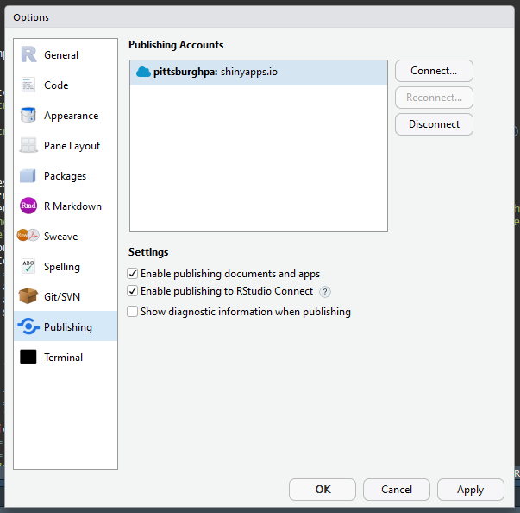
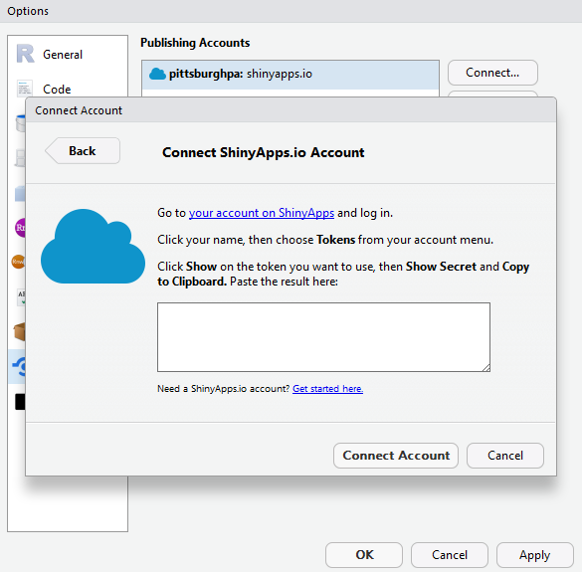
Connect your account

Slide 25

Publish one of todays apps!

Slide 26
For Next class

Slide 27
Please be able to load the following libraries
httr
Make API calls
jsonlite
Easily load and read JSON objects in R

